Slide 2
Bahçeşehir Cyprus University (BAU Cyprus University) is established as a member of BAU Global Education Network. BAU Global Education Network includes higher education institutions and language schools located in three different continents (North America, Europe and Asia). Its purpose is to provide the opportunity for students to benefit from academic means having an equal level and located in different continents and countries, and get an education in different campuses to enable them to have an international vision.

Slide 3
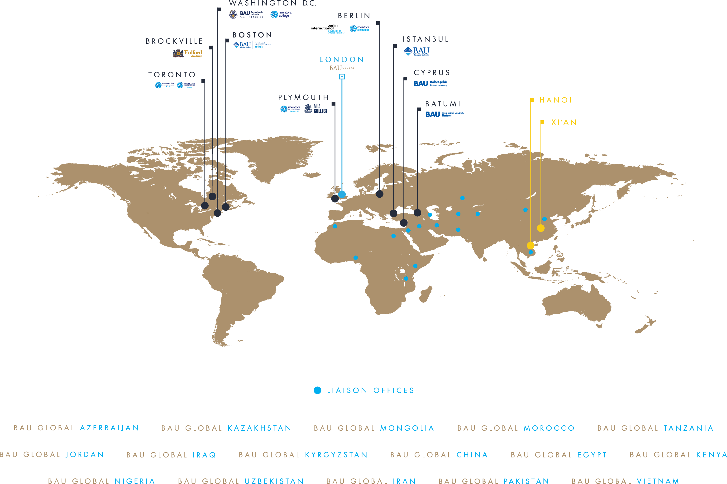

Slide 4
Faculties and Departments

Slide 5
Faculty of Architecture and Engineering
Architecture
Civil Engineering
Computer Engineering
Faculty of Educational Sciences
English language teaching
Faculty of Law
International law
Located on the largest island in the eastern Mediterranean
Nicosia, Cyprus

Slide 6
Vacational School
School of Tourism and Hotel Management
Tourism and Hotel Management
Faculty of Economics, Administrative and social sciences
Management Information Systems
Political Science & International Relations
Psychology
Banking and Finance
Business Administration
Computer programming
Business Managment
Institute of Social and Applied Sciences
Master of Business Administration
Master of Political Science & International Relations

Slide 7
Easy Entry. Scholarship opportunities. Semester Exhange program. Safe Enviorment. low living cost. Student Oriented Island and Campus. Free Transportation. State Scholarship Opportunities. Health Insurance. Its a Home away from Home.
WHY BAU CYPRUS

Slide 8
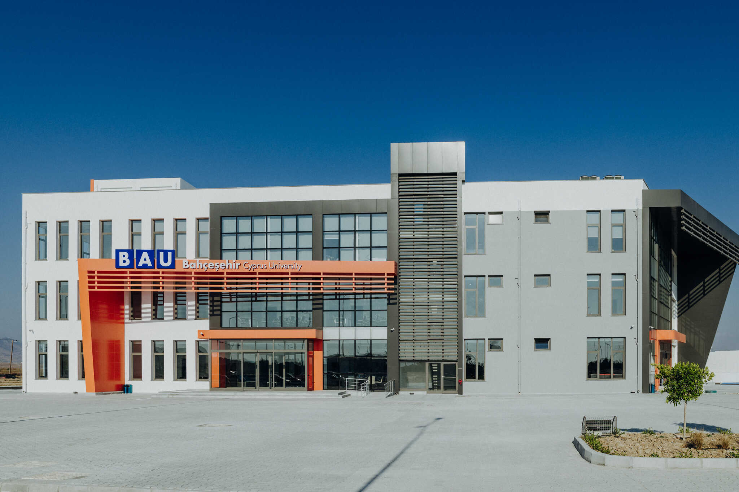
Campus Life
In the maritime center of England
Plymouth, United Kingdom

Slide 9
Accommodation
Single room : 2500-2700 USD per year . Wifi included.
Double room: 1500-1700 USD per person per year . Wifi included.
Renting houses and other dormitory options are available .

Slide 10
Apply Now
Join BAU family today for your tomorrow!!
www.baucyprus.edu.tr

